Slide 1
Introduction to Categorial Logic
Mirko Farina
Assistant Professor
Innopolis University
* I do not claim authorship for all texts and pictures in the presentation.

Slide 2
Summary of Previous Lecture
What is logic
The difference between rhetoric and logic
Difference between a claim and an argument
What is an argument and what are its components
What is an extended argument
How we can identify, reconstruct, and assess an argument
How to interpret an argument (ambiguity, vagueness, rhetorical questions, irony, implicit relative statements, quantifiers)

Slide 3
TODAY’S PLAN
History of Categorical Logic
What is Categorical Logic?
Elements of Categorical Logic
Quantity
Quality
Distribution
2

Slide 4
Historical Overview (Aristotle and the Stoics)
Aristotle forefather of Modern Logic
Aristotelian Logic is known as Syllogistic, Categorical or Term Logic
Aristotle’s theory of Syllogism has had unparalleled influence in Western thought
3

Slide 5
Aristotle’s work on Logic is rich and complex
- Included in the Organon
Consists of several treatises, among them:
Categories
Prior and Posterior Analytics (+)
Topic
On the Interpretation
Sophistical Refutations (+)
4

Slide 6
Aristotelian Logic is based on Deductive Reasoning
AND that is grounded on two ideas/notions or pillars:
Syllogism (argument with exactly 2 premises)
264, Medieval tradition with Boetius, Abelard, Buridano
Terms (atomic units denoting classes/categories of things)
5

Slide 7
BIG ISSUE:
Underlying Aristotle’s magnificent work in Logic there is a deep question
IS LOGIC PART OF PHILOSOPHY (Stoics) OR IS IT A MERE TOOL (Aristotle)?
Aristotle thought that logic should be used to guide metaphysics. Logic was the cornerstone of knowledge, a tool to investigate basic truths.
6

Slide 8
2. What is Categorical Logic?
A fairly simple logic of categories or classes
In this logic, we can say something about all members of a class, called a universal sentence, or we can say something about some members of a class, called a particular sentence. We can also make a positive claim, called an affirmation, or we can make a negative claim, called a negation
11

Slide 9



In categorical logic, important logical terms are the terms “all” and “some.”
In categorical logic we will use capital letters to stand for categories of things in the world, We can represent the statement:
All humans are mortal
as
All H are M
where “H” stands for the category of “humans” and “M” stands for the category, “things that are mortal.” Notice that the categories are nouns or noun phrases.
13

Slide 10
Categorical logic is the logic that deals with the logical relationship between categorical propositions.
A categorical proposition is simply a proposition about a category or type of thing.
12

Slide 11
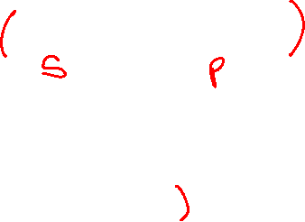
3. Elements of Categorical Logic
EXAMPLE: DOGS ARE ANIMALS (every categorical proposition has two terms)
TWO CATEGORIES/CLASSES HERE
DOGS subject term (not in the grammatical sense but in terms of primary class to be related to the second) - The subject term is a the portion of the proposition that refers to a set of persons, animals, places, or things.
ANIMALS, predicate term (the secondary class to be related to the first)
The predicate term is some quality which the subject is supposed to have.
PROPOSITIONS TYPICALLY COMPARE CATEGORIES OF THINGS OR CLASSES
15

Slide 12
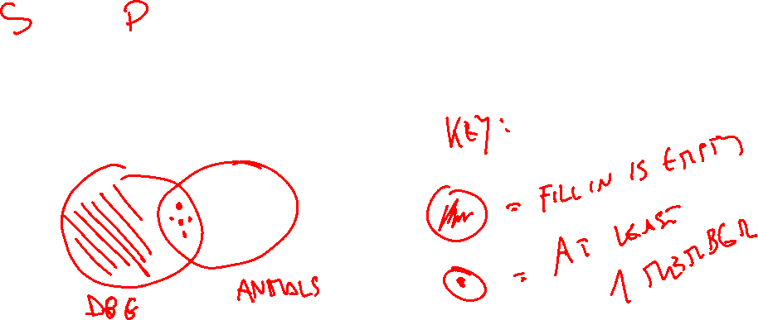
DOGS ARE ANIMALS…. (ALL) DOGS ARE ANIMALS
How the first category relates to the second, helpful means to compare classes
16

Slide 13
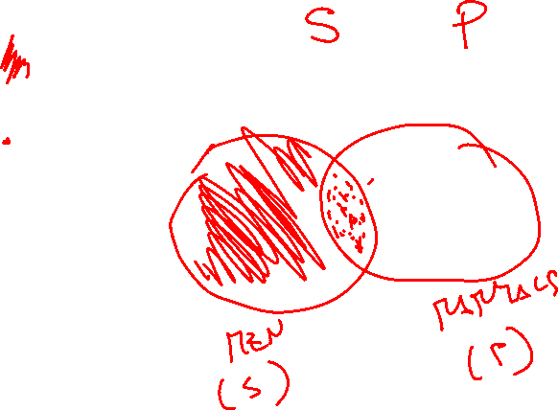
MEN ARE MAMMALS…. (ALL) MEN ARE MAMMALS
17

Slide 14
CATEGORICAL PROPOSITIONS essentially explain the relationship between two categories whether or not –for instance- they need to be excluded, included, OR whether they are universal or particular
18

Slide 15
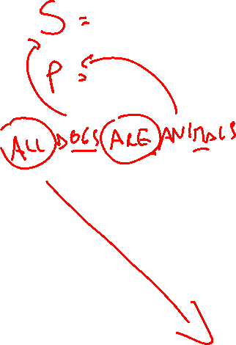
ARE (verbs in general) = COPULA (element that glues predicate and subject term together)
Yet,
We are missing how to determine the quantity (How much) the subject of one class is or is not in the predicate class and vice versa
So, we need QUANTIFIERS –all, none etc- (the final element of categorical logic which take us to standard categorical propositions…)
19

Slide 16
FOUR BASIC ELEMENTS IN CATEGORICAL LOGIC
SUBJECT TERM
PREDICATE TERM
COPULA
QUANTIFIERS
20

Slide 17
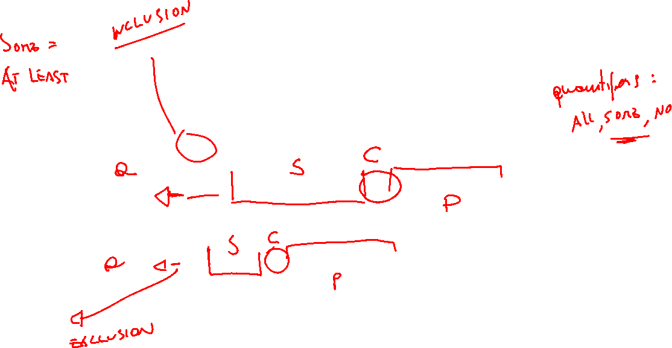
QUICK EXERCISE –individuate subject term, predicate term, copula and quantifier
All mice are rodents.
Some basketball players are seven feet tall.
A few scholars are good athletes.
No sailors are bad swimmers.
Most snakes are harmless.
21

Slide 18
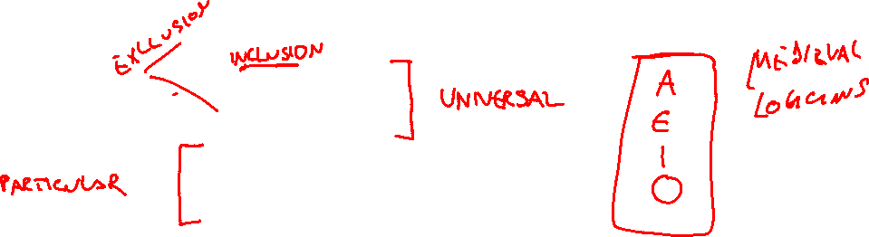
STANDARD FORMS CATEGORICAL PROPOSITIONS
Since, categorical logic asserts that either all or parts of a class denoted by the subject term is included or excluded from the class denoted by the predicate term we have 4 basic categorical propositions:
1. All S are P
2. No S are P
3. Some S are P
4. Some S are not P
22

Slide 19
4. Quantity – how much?
The QUANTITY of a proposition is either universal or particular.
A proposition is UNIVERSAL if its quantifier is ALL or NO.
A proposition is particular if its quantifier is SOME.
9

Slide 20










All S are P
2. No S are P
3. Some S are P
4. Some S are not P
10

Slide 21


5. Quality – in which way?
In what way Are the classes being related?
Affirmative – something is the case
Claim about existence, all the members of one class are related to the members of the second class in a positive sense
Example: all humans are mammals; all mice are rodents
Negative - something is not the case
out of all the class of the first class none of them are members of the second class – they are excluded
Example: No dogs are fishes; no mice are rodents
11

Slide 22
The QUALITY of a proposition is either affirmative or negative.
A proposition is NEGATIVE if the quantifier is NO or the copula is ARE NOT.
A proposition is AFFIRMATIVE if it is not negative, therefore if the quantifier is ALL or the copula is ARE
12

Slide 23






All S are P
2. No S are P
3. Some S are P
4. Some S are not P
10

Slide 24


Porphyry’s Isagoge
b. Boethius’ On the Categorical Syllogism
c. Abelard’s Dialectica
d. Richard of Campsall’ Questions on the Books of the Prior Analytics
e. William of Ockham’s Compendium of Logic
FOUR BASIC FORMS
14

Slide 25
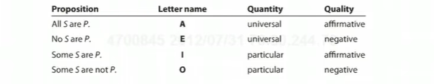





Summing up:
15

Slide 26














EXERCISE
Identify the form of the categorical statements expressed by the following sentences.
All heroes are brave people.
No brave people flee from danger.
Some people who face danger are brave.
Some who flee from danger are not brave.
Philosophers have all studied logic.
Many pre-law students study logic.
There haven't been any philosophers on the moon.
16

Slide 27
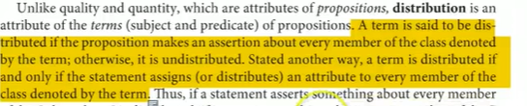



6. Distribution
17

Slide 28
A term in a claim is DISTRIBUTED when it says something definite about all members of a certain category
Distribution is a formal feature. Does not depend on the terms used. The pattern of distribution is the same
18

Slide 29















The A proposition [All S are P] says that every member of the subject class is a member of the predicate class.
Example: All dogs are animals
19

Slide 30





But is reference being made to every member of the predicate class?
NO.
Example: "All artists are eccentric."
You are only saying that if a person is an artist, he is a member of the class of eccentric people (which includes, but goes beyond artists; philosophers are eccentric too!).
20

Slide 31













The E proposition [No S are P] makes reference in a negative way to every member of the subject class. E propositions also assert that not a single member of the S class is a member of the P class, and thus the reference is to the whole of the predicate class.
Example:
no cats are dogs,
no dogs are fishes
21

Slide 32






In the I proposition [some S are P] the quantifier [some] makes it clear that only some members of the subject class are being referred to, so the subject is undistributed (Some S … ).
What about the predicate class?
It is also undistributed because reference is being made to only some of the members of that class not the whole of it.
Example: some men are wealthy
What about women?
22

Slide 33




In the O proposition [Some S are not P] the quantifier "some" shows that the reference is being made to only some of the subject class (Some S …).
What about the predicate class?
It is distributed, because to say that Some S is not P, we have to know the sum total of the P class to make this assertion.
Examples:
Some Men are not Happy
You have to know the sum total of the happy people in order to know that some are not part of it
All those who are not happy will go away . All those in the category who remain are happy
23

Slide 34
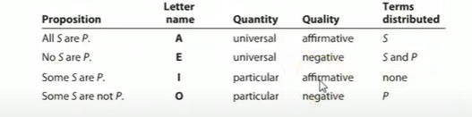

SUMMARY
24

Slide 35
WHAT WE LEARNED TODAY?
History of Categorical Logic
What is Categorical Logic?
Elements of Categorical Logic
Quantity
Quality
Distribution
25

